Slide 1

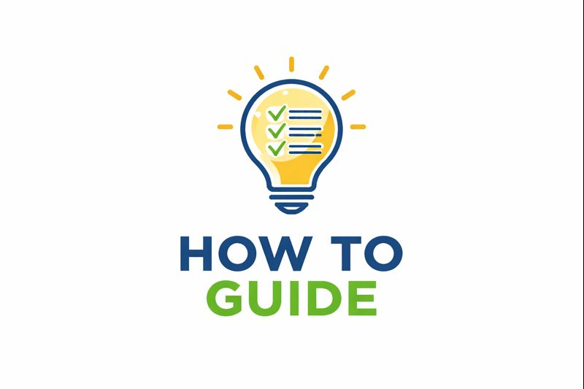
BWSW JustGo Membership Platform
Club/Centre Membership Guide
﻿This guide will show you how to manage/view your club/centre members, add and remove members and process membership payments

Slide 2
BWSW JustGo Membership Platform
Club/Centre Membership Guide
You will have certain permissions and functions available to you depending on the role that has been allocated to your account for your club/centre. You will automatically be granted the relevant access permissions by logging in to your own personal account

Slide 3
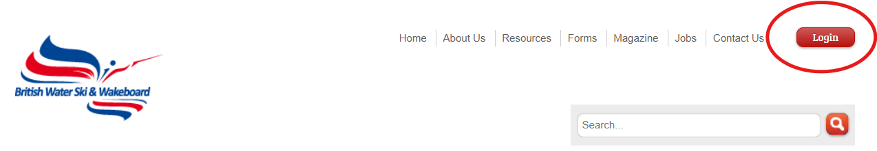
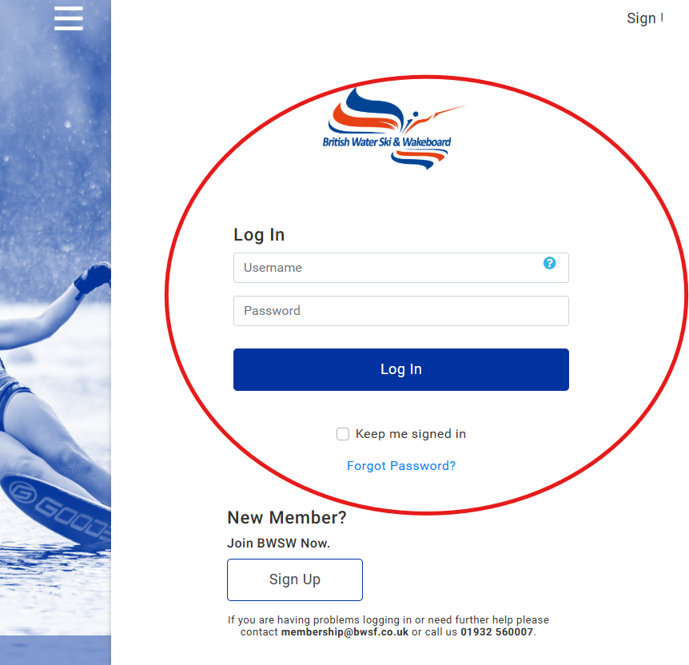
BWSW JustGo Membership Platform
Club/Centre Membership Guide
You will firstly need to sign in to your membership profile. From the BWSW website, click on the ‘login’ button
You will then be taken to the membership platform login page. Log in to view your membership profile

Slide 4
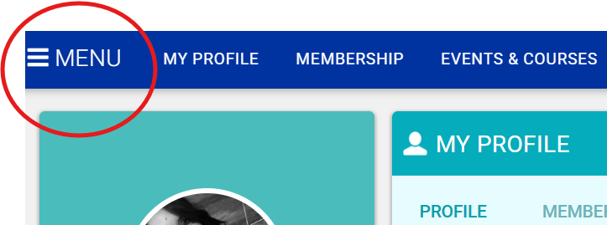
BWSW JustGo Membership Platform
Getting Started
Once you have logged in, click on the ‘menu’ button which is shown, on the top left-hand side of the screen

Slide 5
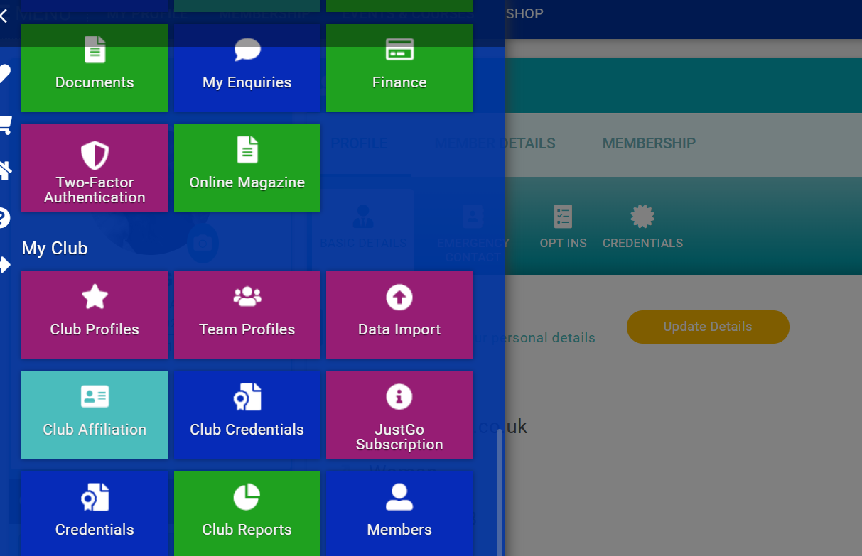
BWSW JustGo Membership Platform
Members Tile
Depending on your role and permissions, you will then see various tiles available to you. Under the ‘My Club’ section, you will have tiles available to you which are only related to your club

Slide 6
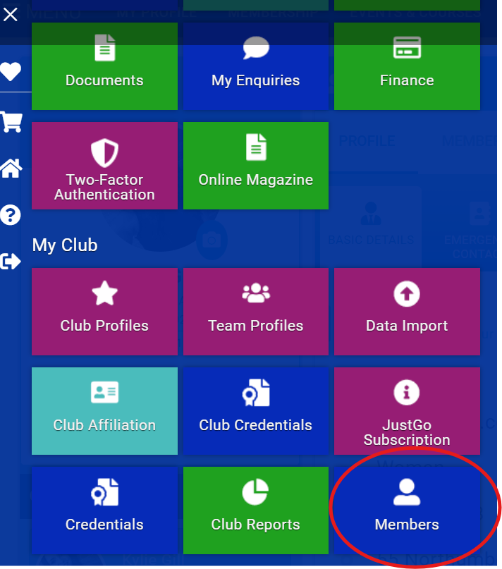
BWSW JustGo Membership Platform
Members Tile
To view your members, click on the ‘Members’ tile

Slide 7
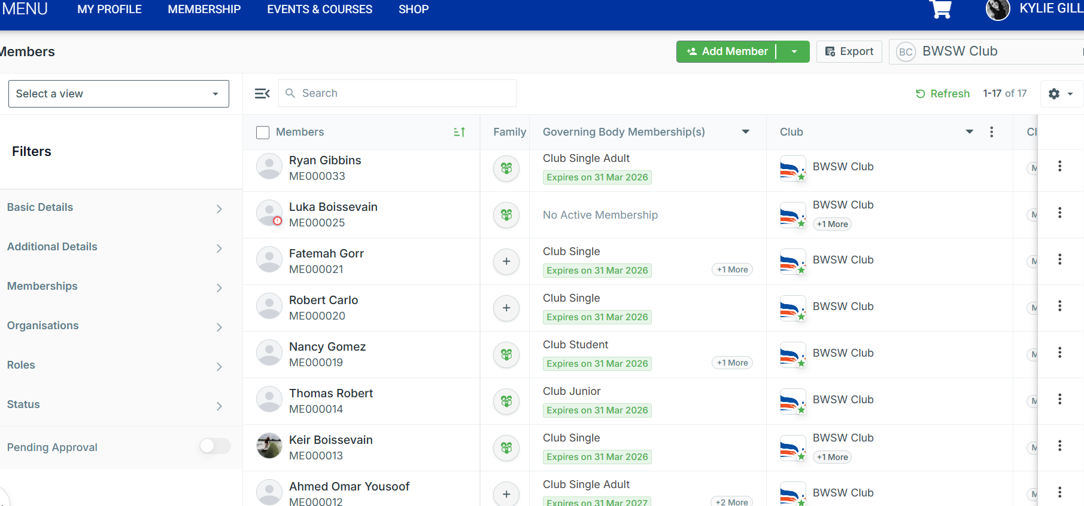
BWSW JustGo Membership Platform
Members List
You will then see a list of all members associated with your club/centre. This is a full list of anyone linked with your club/centre, regardless of their membership status or relationship with the club/centre

Slide 8
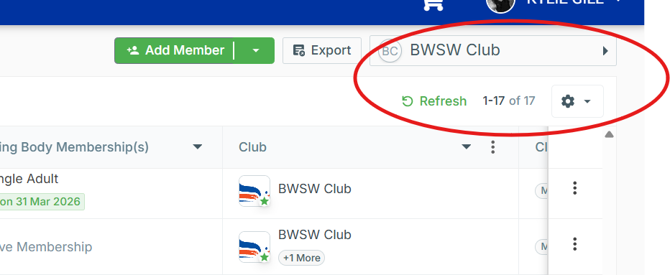
BWSW JustGo Membership Platform
Members List
If you are an admin member of more than one club/centre – you will see here the current one that you are viewing. You can select this box and switch to view another club/centre if you have permissions to do so

Slide 9
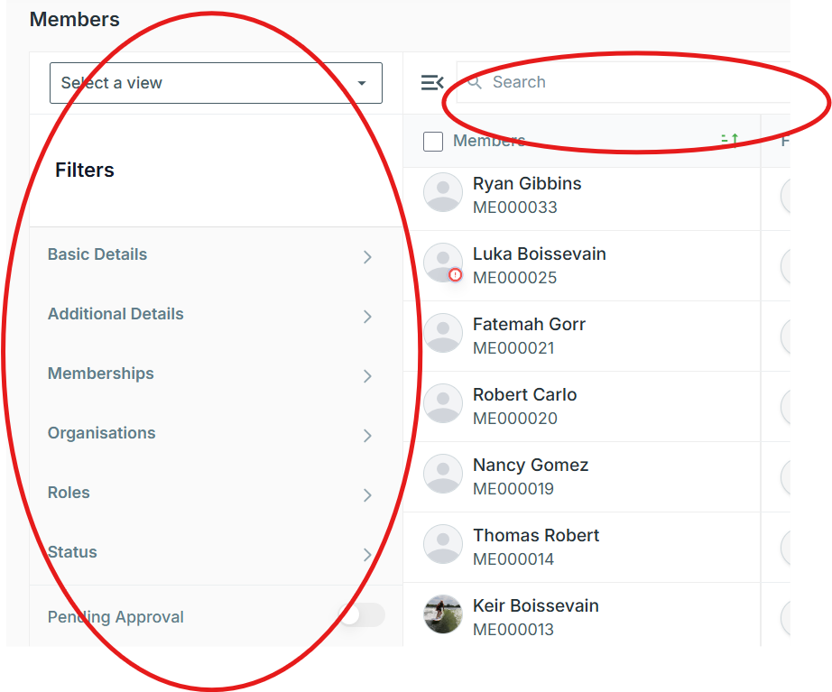
BWSW JustGo Membership Platform
Members List
You can either use the filter to search for a member(s) or type their name in the search bar

Slide 10
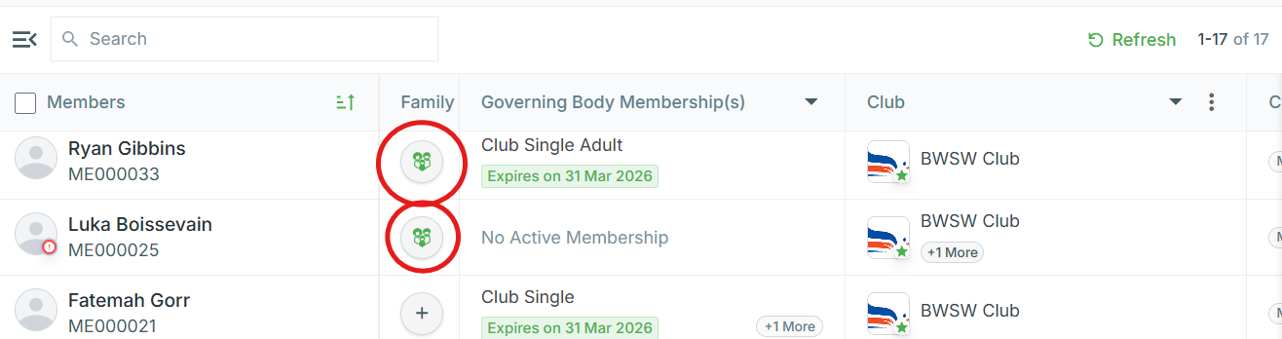
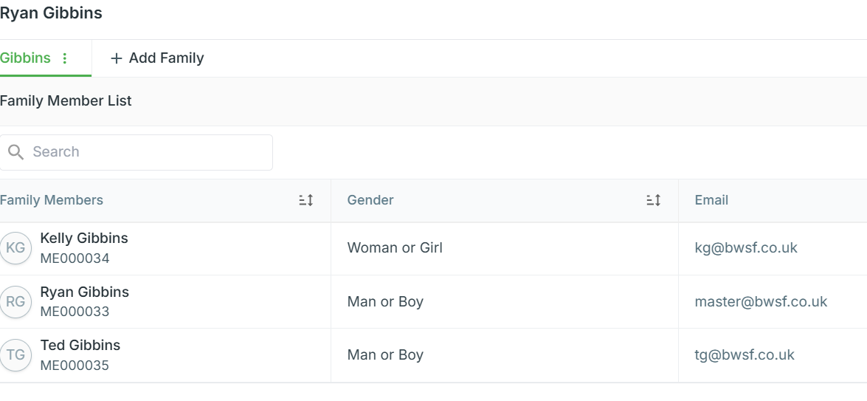
BWSW JustGo Membership Platform
Members List
If you have any members that have a family link, this icon will show under the family heading. You can click on the icon, and it will load details of the family members as shown on the screenshot

Slide 11
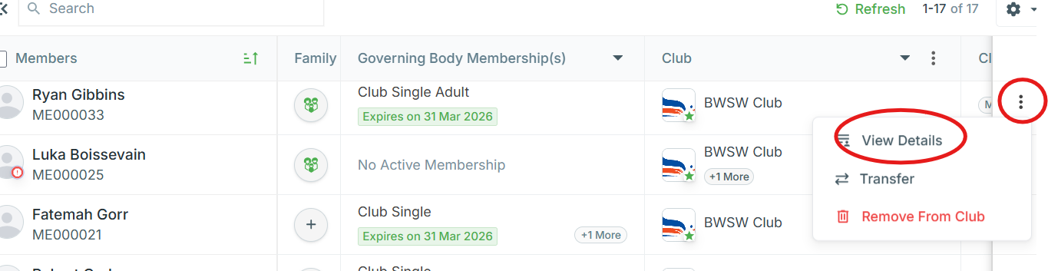
BWSW JustGo Membership Platform
Members List
To view a member either simply click on their name or click the 3 dots which will open a small window (as shown) where you can then select ‘View Details’ .
The transfer button is not a feature we will be using so can be ignored

Slide 12
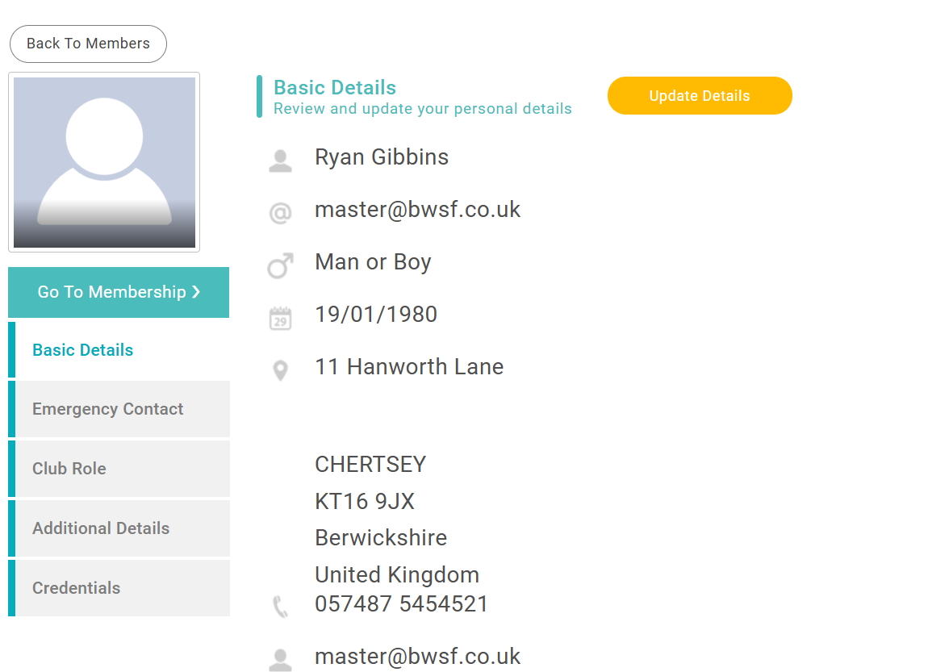
BWSW JustGo Membership Platform
Member profile
Once you have selected a member to view, you will see their individual profile details in a new window

Slide 13
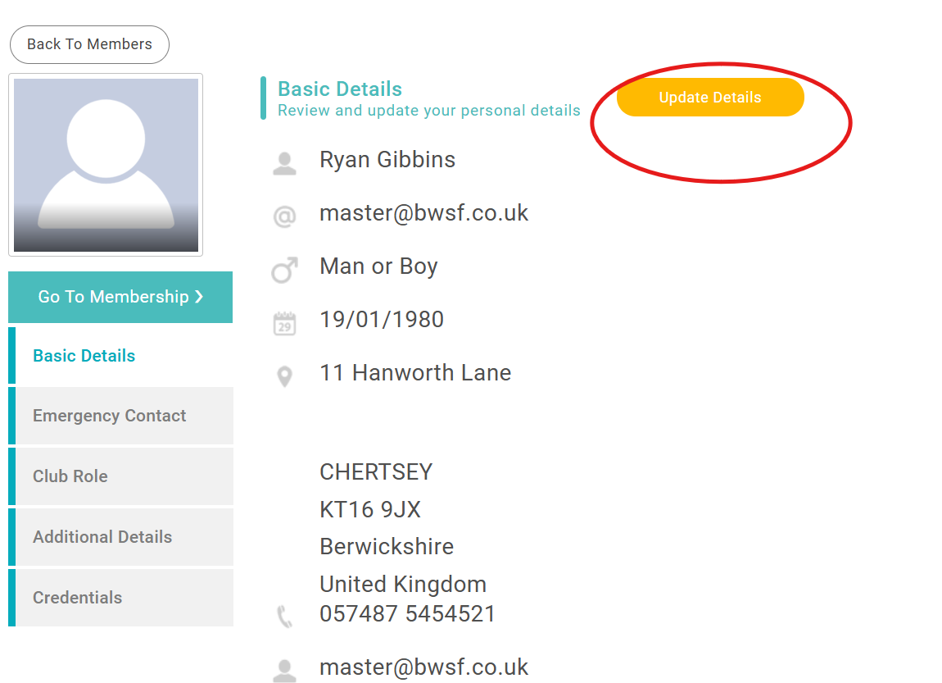
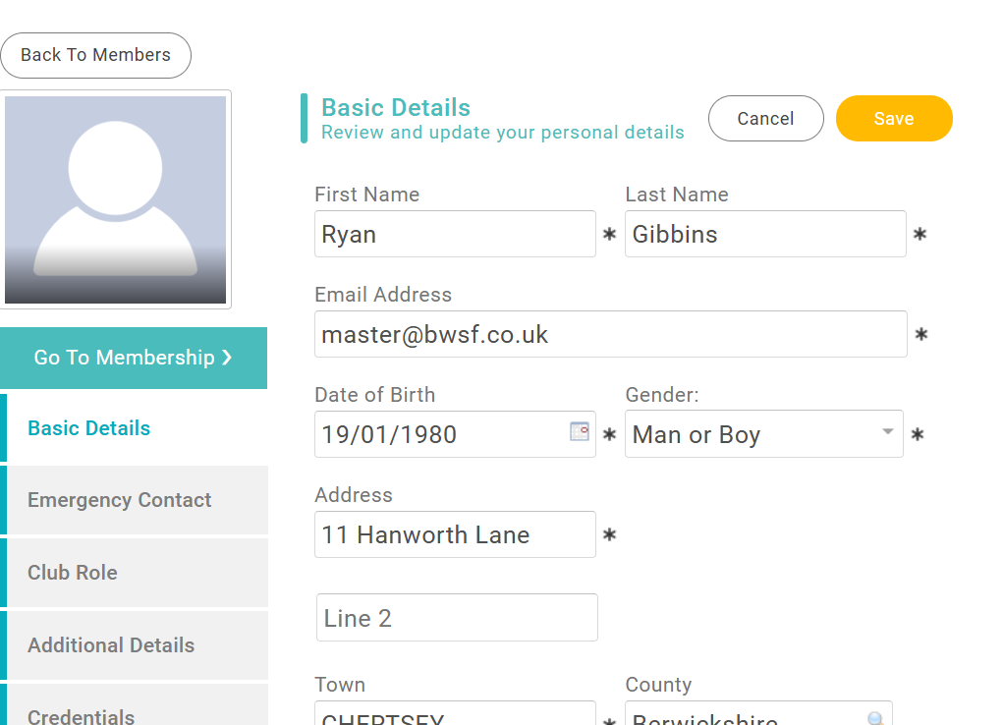
BWSW JustGo Membership Platform
Updating member details
By clicking on ‘Update Details’, you will then be able to edit the basic details for that member

Slide 14
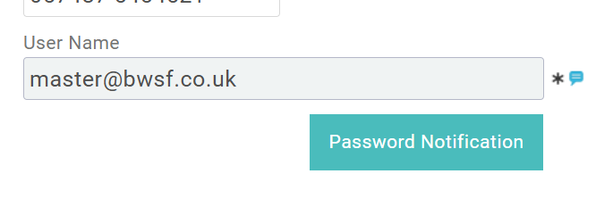
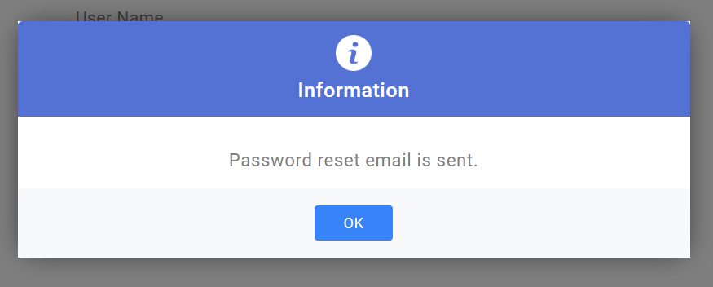
BWSW JustGo Membership Platform
Updating member details
There is a ‘Password Notification’ box at the bottom of the basic details page which will allow you to send a ‘password reset email’ to the individual, if they have not yet created an account or possibly forgotten their password

Slide 15
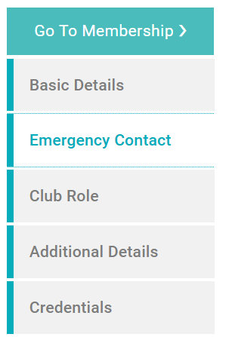
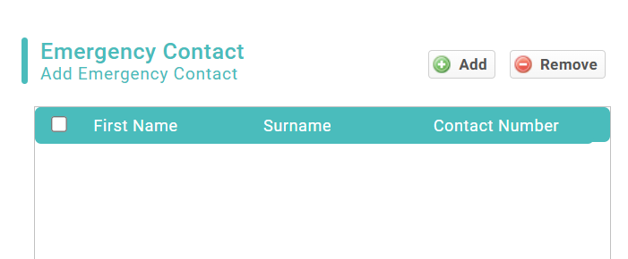
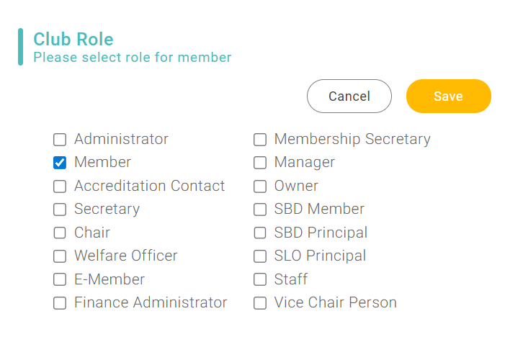
BWSW JustGo Membership Platform
Updating member details
The options on the side bar will allow you to navigate to various information on the individual. You can add an emergency contact and ‘Club Role’ is where you would allocate certain roles to an individual. Please be careful when assigning roles as certain roles will grant higher permissions and access to members details

Slide 16
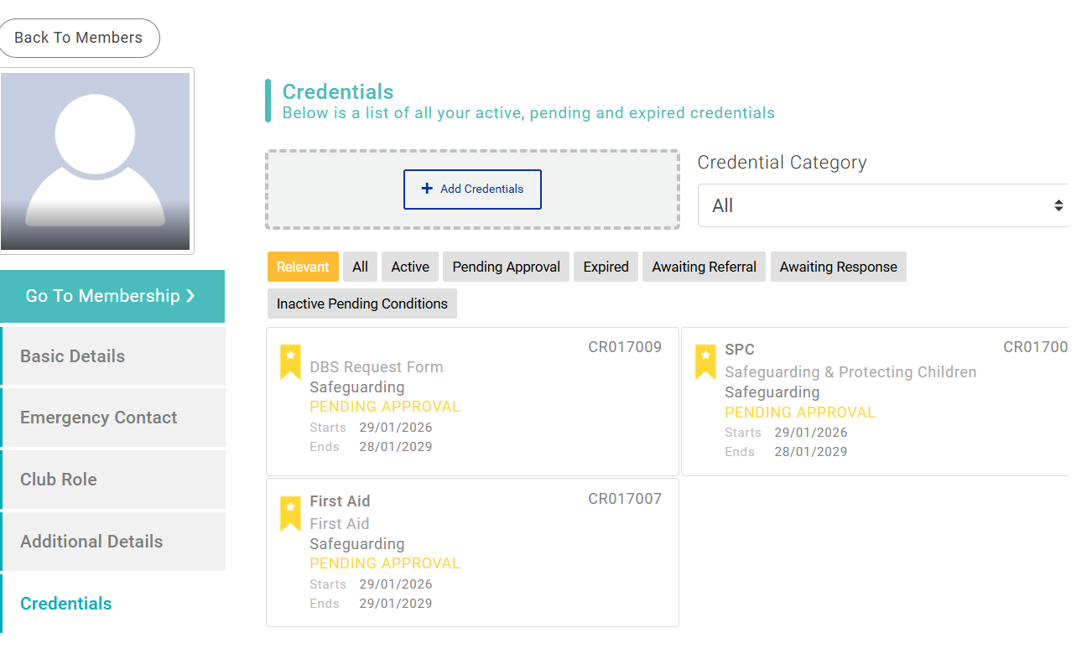
BWSW JustGo Membership Platform
Credentials
Credentials will show any licences, qualifications, certification and any other attributes the individual holds. You will see that the status is shown on each credential – in the screenshot shown, the certificates are pending approval from BWSW. By selecting the credential, you will have more information available to you regarding the status. In instances where pre-requisites are required for a qualification for example, this will be shown

Slide 17
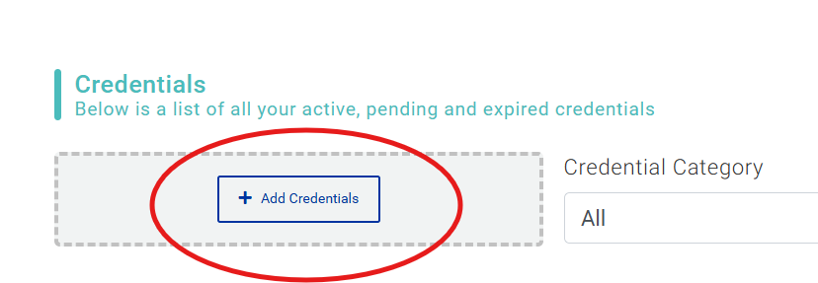
BWSW JustGo Membership Platform
Credentials
You will be restricted as to what credentials you can add for an individual, and for yourself. In most cases, the credential will be sent to BWSW for approval

Slide 18
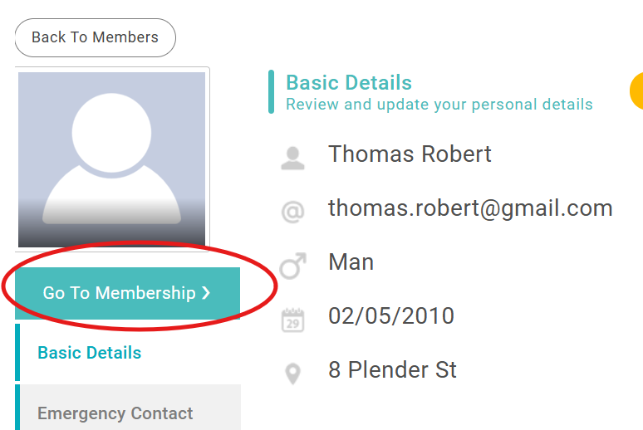
BWSW JustGo Membership Platform
Membership
To view, amend or add membership for the individual, click on ‘Go To Membership’

Slide 19
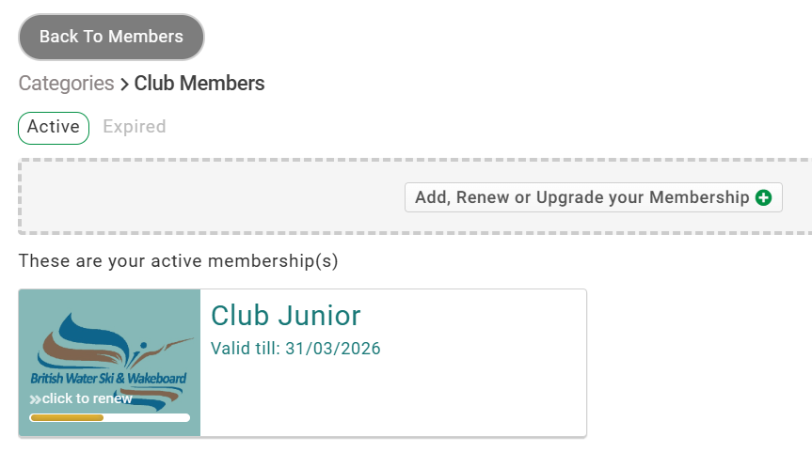
BWSW JustGo Membership Platform
Membership
You will now see the current membership the individual has, which is showing as active but is available to be renewed. There is a ‘bulk renewal’ function which would be a preferred method if you have multiple memberships to renew. If you are renewing one membership, you can proceed with this method

Slide 20
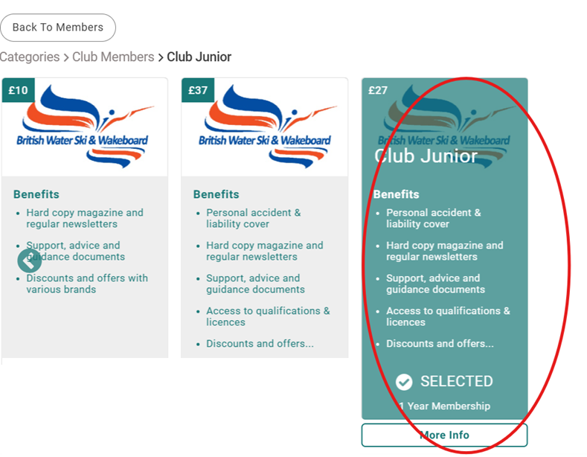
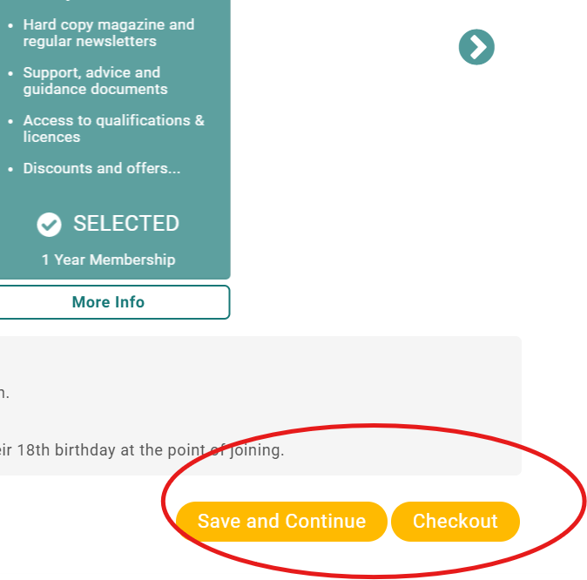
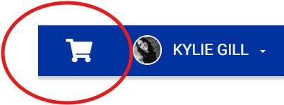
BWSW JustGo Membership Platform
Membership
The membership category has been automatically selected for the individual based on the previous membership or what is now available. For example, if this junior had now turned 19, a junior membership would not be available for selection. You can then save and continue if you need to edit another membership or move to the checkout (you can return to your basket at any point by selecting the basket icon near your name). Information on making payments is included further in this guide. If you wish to exit, click ‘Back To Members’ at the top

Slide 21
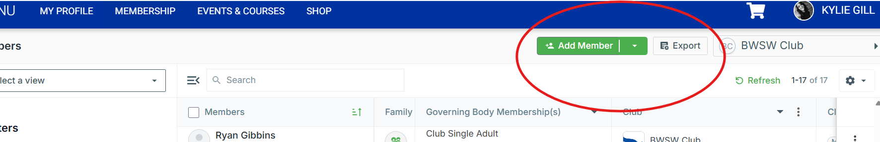
BWSW JustGo Membership Platform
Adding a new member
To add a new member, click on ‘Add Member’ at the top of the club members list page

Slide 22
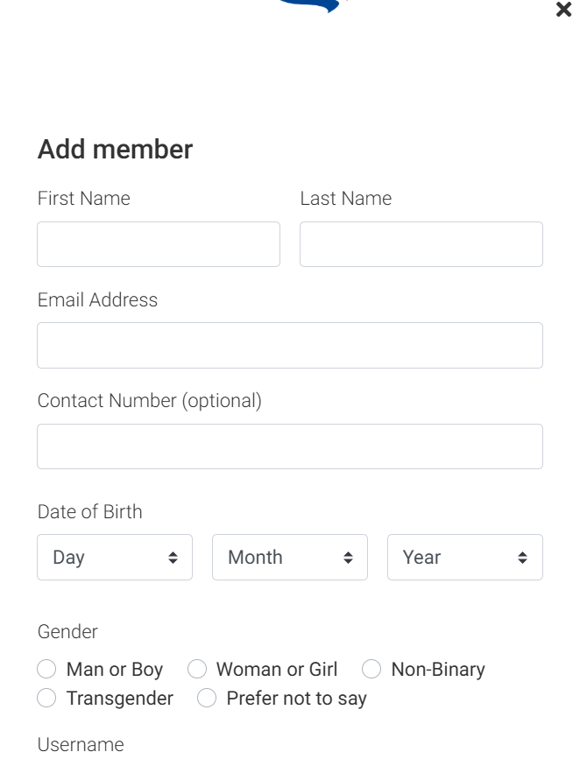
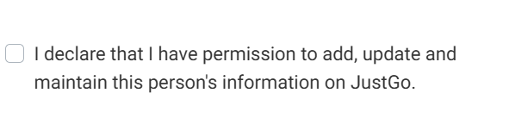
BWSW JustGo Membership Platform
Adding a new member
This will bring up a form which is similar to the sign-up form where you will enter the personal details for the individual. Ensure you enter all their details accurately. An email address must be entered for any individual being added. In the case of a child, we have allowed the facility to add a duplicate email address. Please ensure that entering duplicate email addresses is restricted to children only where an email address does not exist. Once you have entered all details, you will need to tick the declaration box

Slide 23
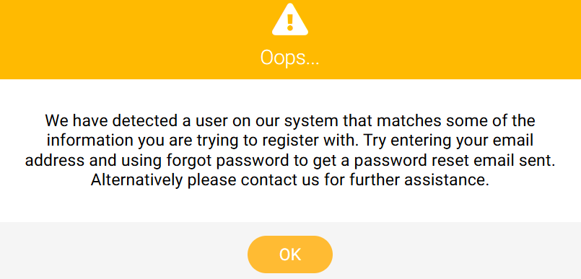
BWSW JustGo Membership Platform
Adding a new member
The membership database will attempt to go through a de-duplication process to ensure that the same individual is not added twice. Please contact us if you are having difficulties here which are blocking you from proceeding
membership@bwsf.co.uk

Slide 24
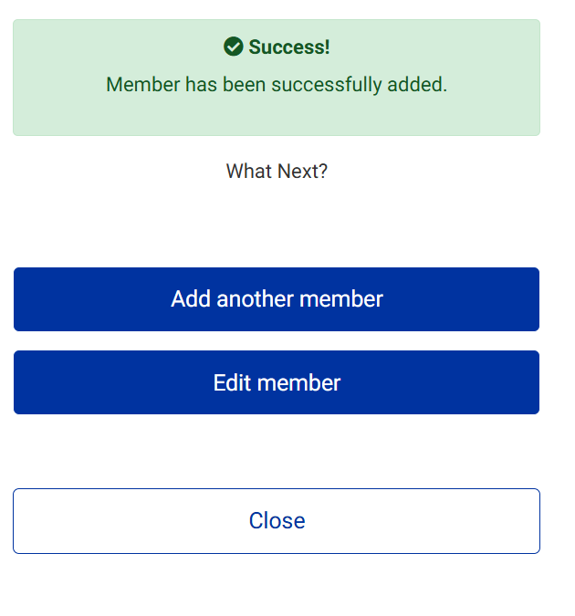
BWSW JustGo Membership Platform
Adding a new member
If the individual has been added, you will receive a Success message. The individual will be sent an email advising them that they have been added to your club/centre and will prompt them to login to the platform. You can then add another member or edit this member. If you add another member, the address entered previously will be entered as default

Slide 25
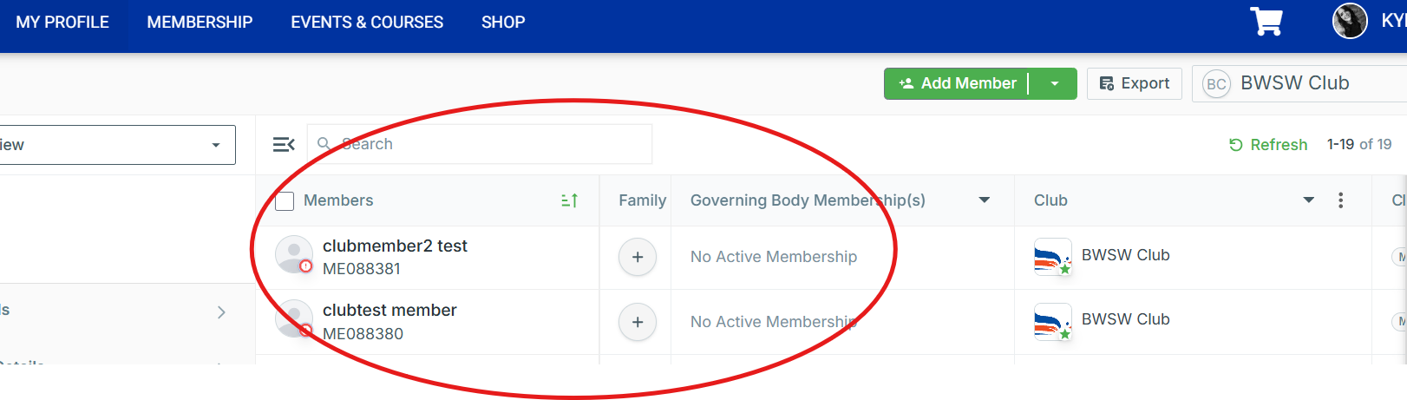
BWSW JustGo Membership Platform
Return to members list
Once you have finished adding any new members, you can return to the club list page. You may need to refresh your browser for the new members to be displayed

Slide 26
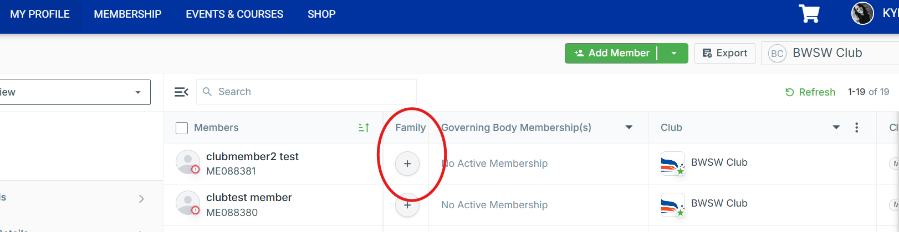
BWSW JustGo Membership Platform
Family membership
If the members you have added are a family, you will need to click on the ‘+’ icon to link them as family members

Slide 27
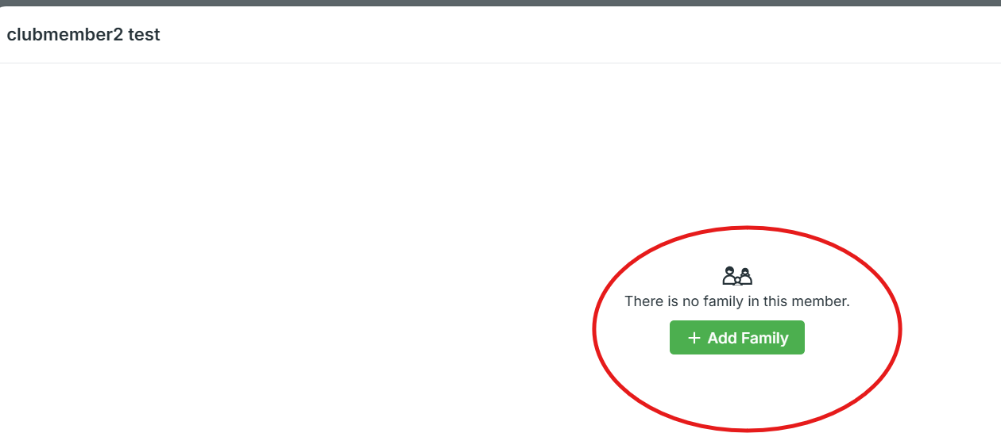
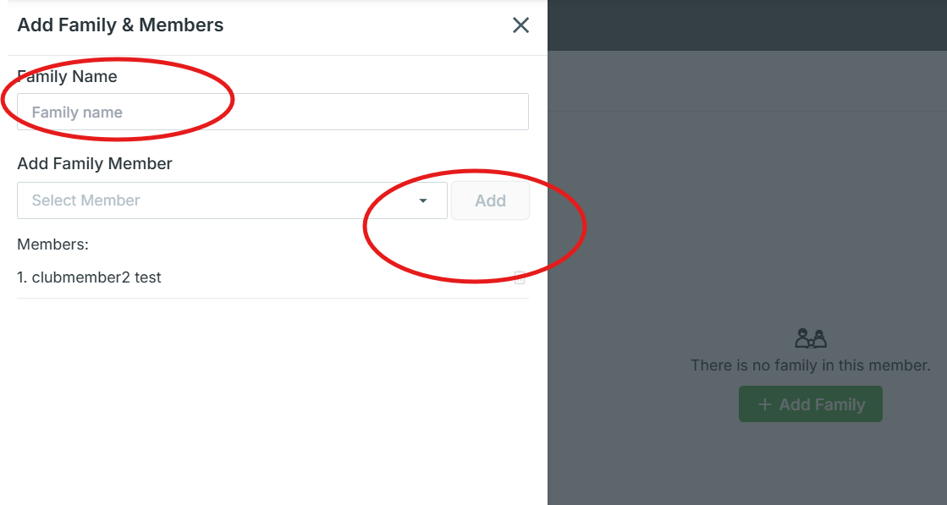
BWSW JustGo Membership Platform
Family membership
After clicking on the ‘+’ icon you will have a new window open, click on ‘+ Add Family’ and on the left-hand side, you will then be able to add family members. The platform will ask you to choose a family name, and then use the drop-down menu to select members to add

Slide 28
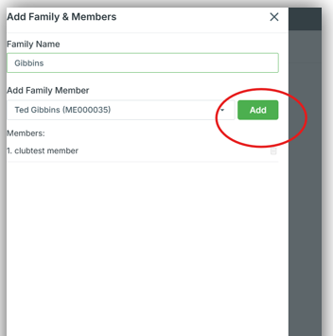
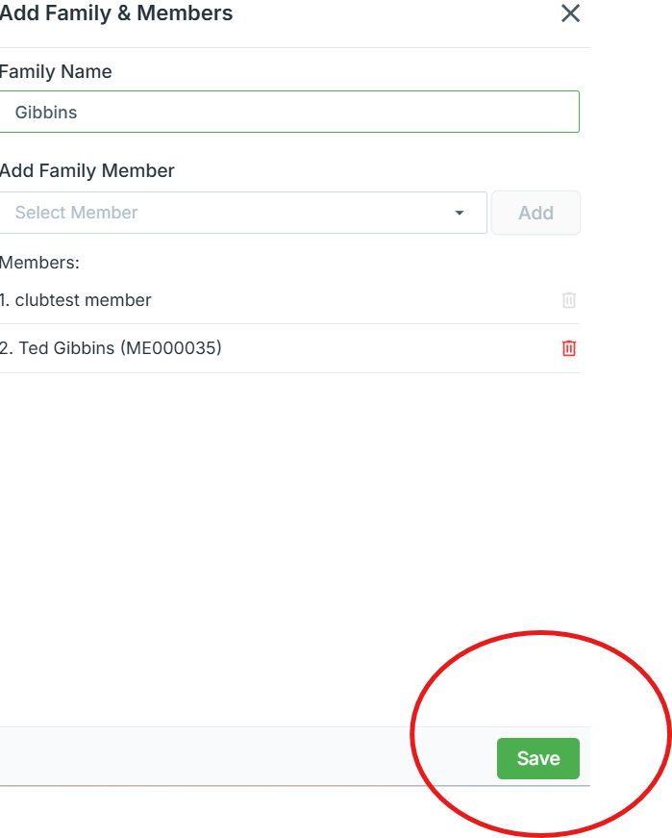
BWSW JustGo Membership Platform
Family membership
Once you have chosen a family name and added a family member, click on ‘add’ to add them to the family, add additional family members now if you need to. Once all members have been added to the family, click on ‘save’

Slide 29
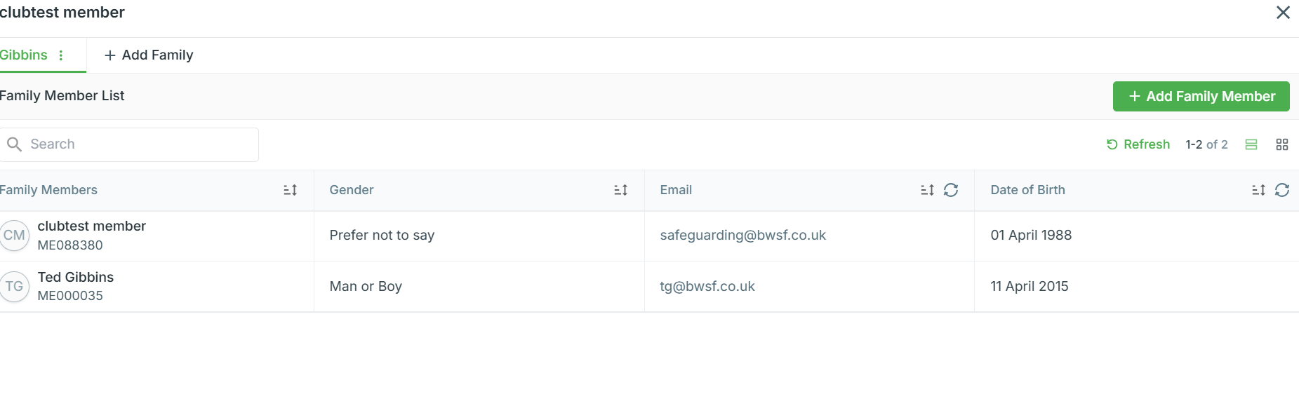
BWSW JustGo Membership Platform
Family membership
You will then see a screen to show that the family members have been linked together. You can add further family members if needed or close this box to return to the members list page

Slide 30
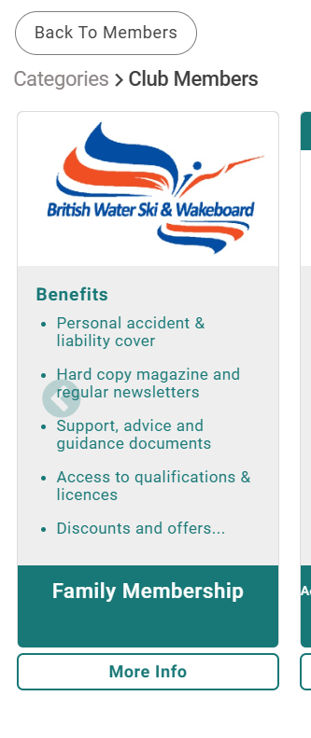
BWSW JustGo Membership Platform
Family membership
The family membership payment process will look quite different to how this has been done previously. Start by selecting one of the family members and selecting ‘Go To Membership’. Then select the Family Membership Plan

Slide 31
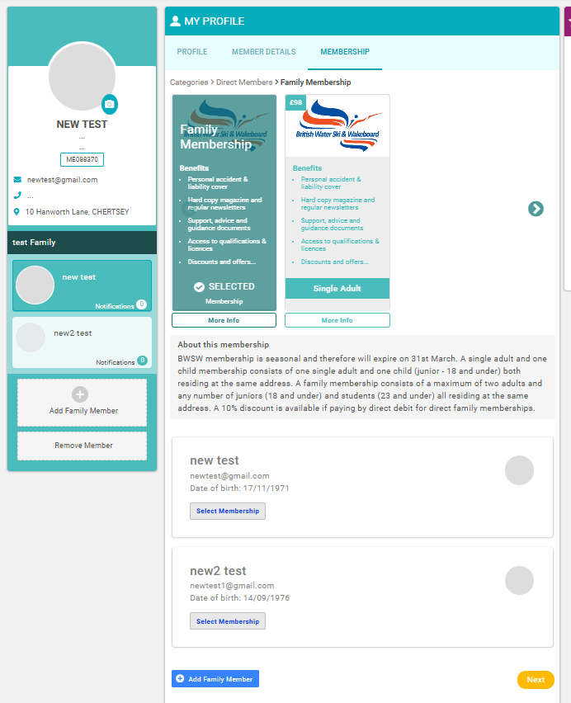
BWSW JustGo Membership Platform
Family membership
If you have chosen ‘Family Membership’ you will see any linked individuals to the main individuals account, below the ‘About’ section.
Each member will need a membership plan selected individually to them. In the case that someone is a child, a junior plan will need to be selected, regardless of the family membership purchase you are doing

Slide 32
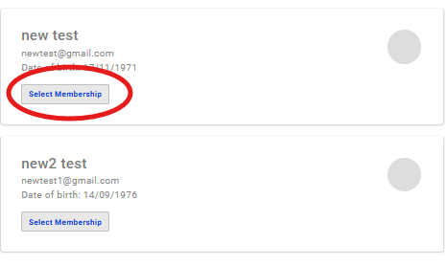
BWSW JustGo Membership Platform
Family membership
Click on ‘Select Membership’ on the first family member

Slide 33
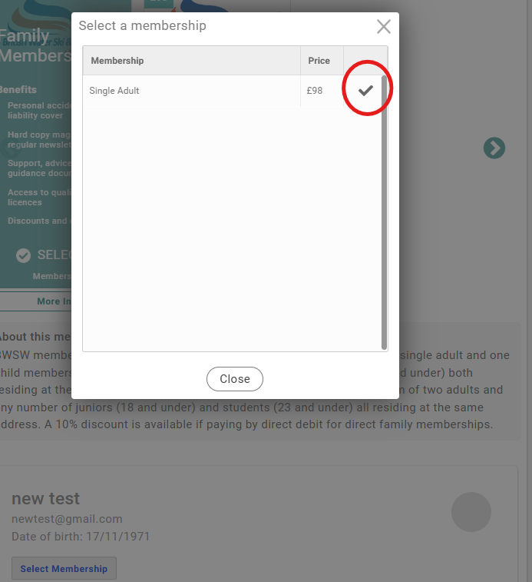
BWSW JustGo Membership Platform
Family membership
This pop-up window will be shown where you will be prompted to select a membership category for this individual. Note: ‘family’ will not be shown as an option here, this selection is based on age/individual category status of the individual. Once you complete the selections and are at the checkout point, you will see that the platform has calculated the family membership fee due.
Select the tick to confirm the membership plan

Slide 34
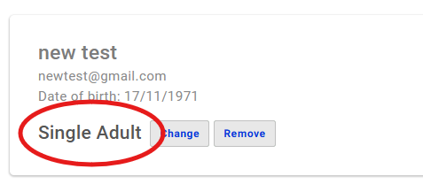
BWSW JustGo Membership Platform
Family membership
You will then see the membership plan you have selected has been allocated to that individual

Slide 35
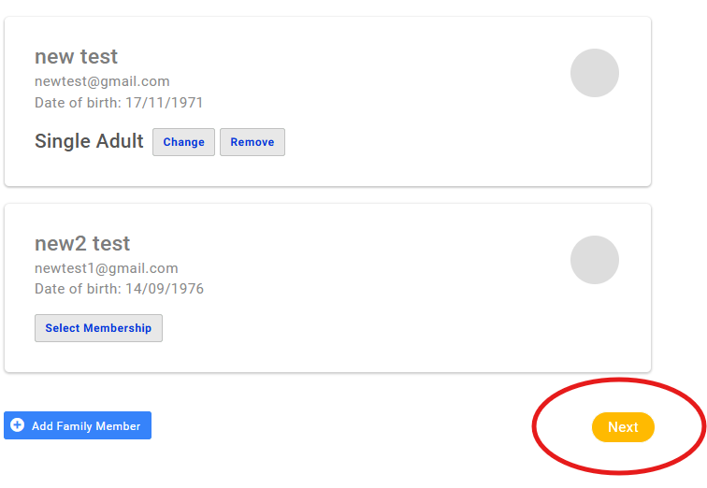
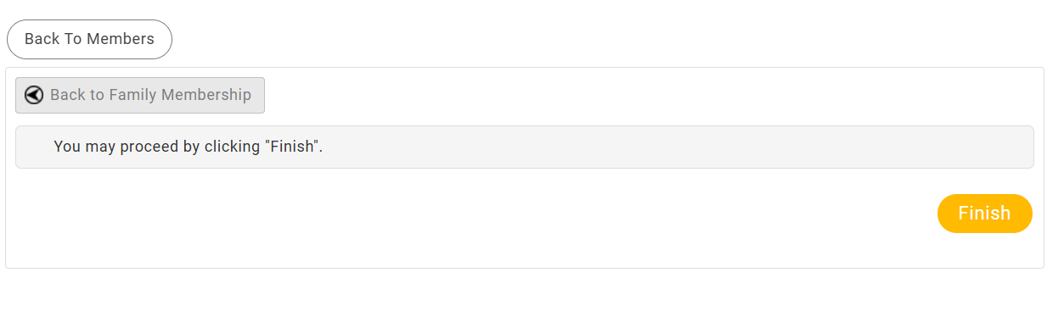
BWSW JustGo Membership Platform
Family membership
Repeat the process, adding all individual family members that are required.
When all individuals are added to the family membership, select ‘Next’. A new window will appear, and you will need to select ‘Finish’

Slide 36
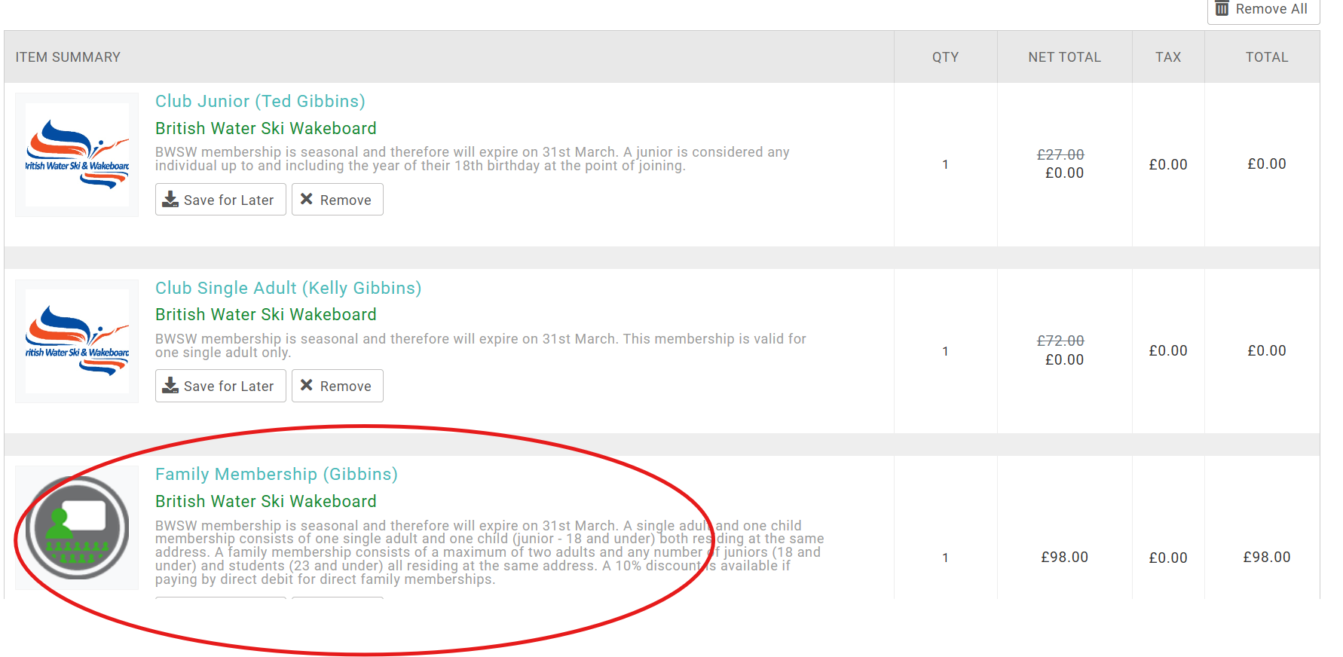
BWSW JustGo Membership Platform
Family membership
You will now be taken to the cart. You will see that the individual plans you have selected for each family member will appear. If a family membership category is available, depending on the criteria of the individuals, the platform will automatically calculate the family membership fee that is due and will show a family membership charge at the bottom of the payment selection. If you wish to continue, follow the payment steps depending on how you will be making payment

Slide 37
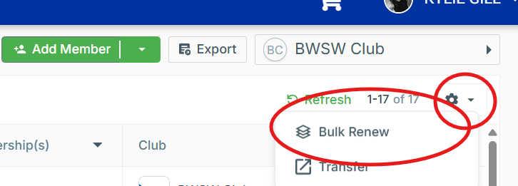
BWSW JustGo Membership Platform
Bulk renewal
We will now take you through the bulk renewal process prior to guiding you on making payments. From the member list page, click on the cog icon and select ‘Bulk Renew’

Slide 38
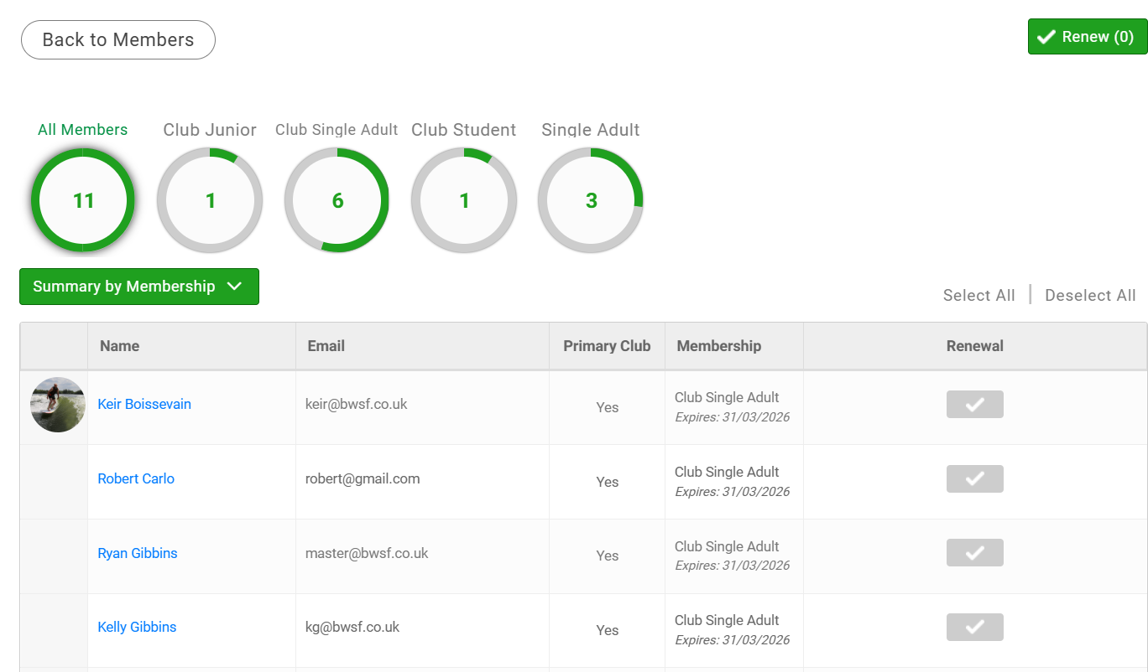
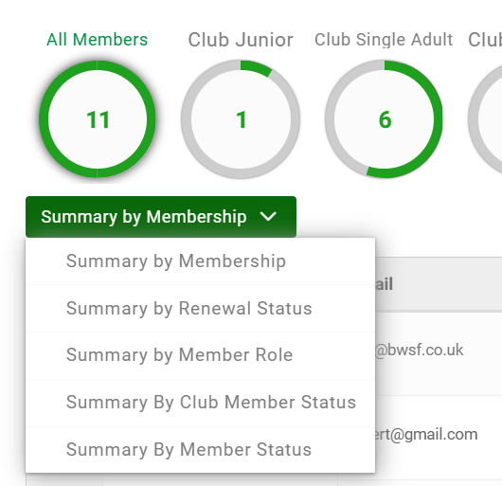
BWSW JustGo Membership Platform
Bulk renewal
This will display a user-friendly summary of your current members. The summary of membership will change the stats of how you are viewing your members.

Slide 39


BWSW JustGo Membership Platform
Bulk renewal
To bulk renew, you can either choose to ‘Select All’ or ‘Deselect All’ or you can click the ‘Tick Box’ which will select the individuals you wish to renew. You can only tick those where a membership plan has already been allocated, either by yourself or as they are a renewing member

Slide 40

BWSW JustGo Membership Platform
Bulk renewal
If you see this message, it is likely that some essential information is missing regarding the individual, which will need to be entered prior to adding them as part of your bulk renewal. The most likely missing data will be the date of birth. You can run a report (shown later) to find all members who have a date of birth missing

Slide 41

BWSW JustGo Membership Platform
Bulk renewal
If you see this message, it will mean that this particular charge is a direct member charge.
If no club member charge is showing, you will need to add one prior to including the individual as part of the bulk renewal

Slide 42

BWSW JustGo Membership Platform
Bulk renewal
Once you have selected all members you wish to renew, click on ‘Renew’ which will be on the top right-hand corner

Slide 43

BWSW JustGo Membership Platform
Bulk renewal
You will then see this pop-up. You can select ‘No, not yet’ which will return you to your members list, or ‘Yes, Proceed to Cart’ to checkout. Remember, you can return to your basket at any point by clicking on the basket/shopping cart icon by your name

Slide 44

BWSW JustGo Membership Platform
Bulk renewal
If you have chosen to checkout, you will then see a summary of the memberships selected and the amount due. If you are unable to make payment now, you can leave this here and the items will remain in your basket until you have either paid for them, or they have been removed. You can choose to pay by bank transfer or by card – simply select the preferred option and follow the payment steps.
We will no longer be accepting cheques

Slide 45

BWSW JustGo Membership Platform
Successful payment
If payment has been accepted, you will receive a successful message and an email confirmation. You can request to download a receipt. The members that you have renewed will also receive an email confirming this. The payment of successful membership is instant and therefore, the members profile will show an active membership status immediately

Slide 46

BWSW JustGo Membership Platform
Removing a member
To remove a member either simply click on their name or click the 3 dots which will open a small window as shown where you can then select ‘Remove from Club’

Slide 47



BWSW JustGo Membership Platform
Removing a member
The system will ask you to enter a reason for removing the individual. Enter a reason and click on ‘Confirm’. You will then see a brief confirmation that this member has been removed from the club/centre

Slide 48

BWSW JustGo Membership Platform
Club Reports
Via the ‘bulk renewal’ process, you saw a quick view of your current members. You can also access and create reports. From the menu, where the tiles are shown, click on ‘Club Reports’

Slide 49

BWSW JustGo Membership Platform
Club Reports
You will then land of the dashboard. Under ‘Category’, you will see some reports that have already been created and are available for you to access

Slide 50


BWSW JustGo Membership Platform
Club Reports
If you click on ‘Members’ for example, you will see the 4 available reports. We have created one specifically for BWSW clubs that has been highlighted which will shown a list of all members, their details, current membership and names of family members they are joined with. Note: it will not show membership plan fees. You can then export the list if needed

Slide 51
BWSW JustGo Membership Platform
Club Reports
The ‘Club Members’ report will allow you to export a list of your current linked club members, along with their personal information. You can use the filter options on Excel here to find those with missing information (i.e the date of birth for the bulk renewal process)

Slide 52
BWSW JustGo Membership Platform
FAQs
﻿We realise this is a very different method to how memberships have been managed and processed in the past, and you may have a few questions. Please view some anticipated FAQ’s on the next slide
FAQs

Slide 53
BWSW JustGo Membership Platform
FAQ’S
﻿Q: What if the individual administering membership, is not the same individual making payments for the club/centre
A: Your items do remain in your cart, but only on your account profile. You will need to contact us to setup a ‘club/centre administrator’ account which can be setup on a shared club email address for additional individuals to access
Q: We usually send a list of our members to you and then make a payment separately; can we still do this?
A: We are trying to streamline our processes and be more efficient. If this is the only option, of course we can still assist. You will have an option to produce a report to send us a list of members you would like to renew. This will not calculate the fee due, but we can do that for you and notify you of the total amount due. You can then make a BACS payment direct to our account if needed
Q: Can our club/centre members renew their own membership?
A: Unfortunately, not. The renewal process of clubs/centres administering memberships will remain. This is part of your Affiliation/Accreditation requirements to ensure that all your members are renewed to BWSW. However, they will always have direct access to their membership status and their account/profile

